Slide 1
Lecture 12: Thermodynamics
California State University, Fullerton
2023 Fall Semester – Chem 123

Slide 2
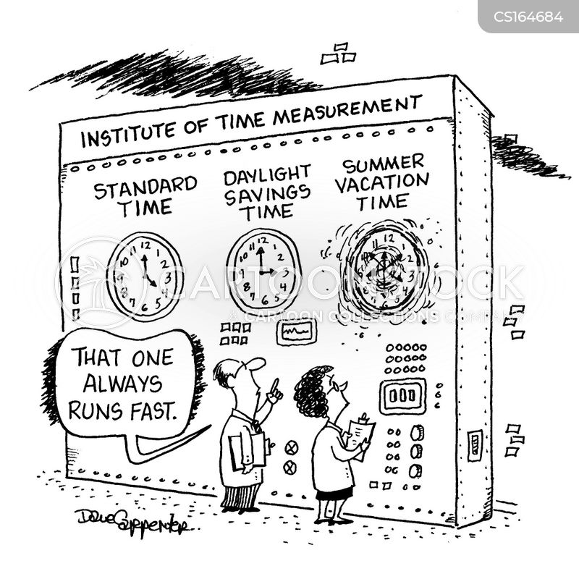
QUESTIONS, COMMENTS, AND CONCERNS?

Slide 3
Outline
Announcements
Ch. 6 & 18: Thermodynamics
Highlights of prior lecture
Enthalpy – Endothermic and exothermic processes
Specific Heat and Calculations
Calorimetry – Measuring energy changes
Enthalpy changes in chemical reactions

Slide 4
announcements
Lots of grading to catch up on. Thank you for your patience
Take ownership of your learning
Reminder: Ch 6 homework to Oct 12th at 11:59 pm
In-Class: Heat worksheet this Weds, Oct 11
Exam 2 will cover Chs. 5 – 7
5-6 questions all free response
Practice! Practice! Practice!

Slide 5
Outline
Announcements
Ch. 6 & 18: Thermodynamics
Highlights of prior lecture
Enthalpy – Endothermic and exothermic processes
Specific Heat and Calculations
Calorimetry – Measuring energy changes
Enthalpy changes in chemical reactions

Slide 6
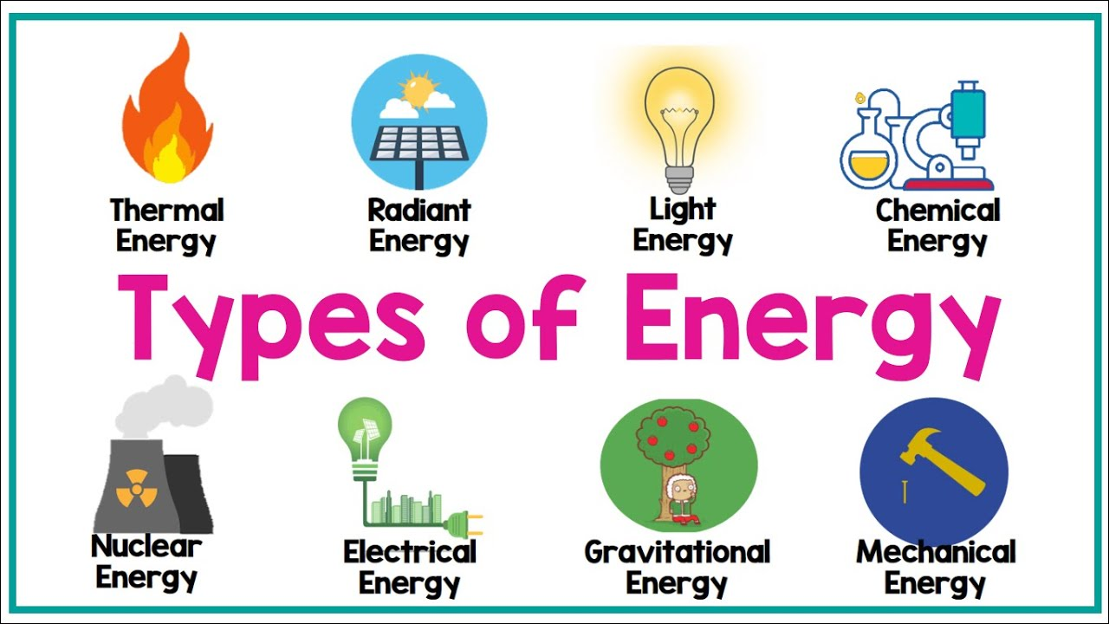
Thermodynamics
Definition: the relations between heat and other forms of energy (such as mechanical, electrical, or chemical energy)the relations between heat and other forms of energy (such as mechanical, electrical, or chemical energy)

Slide 7
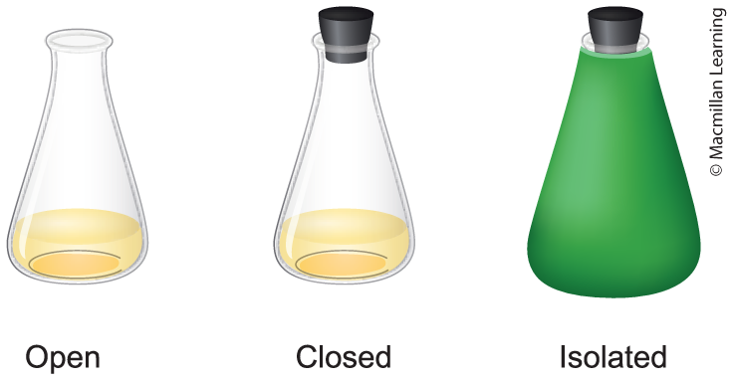
System and the surrounding
E(Universe) = E(System) + E(Surrounding)
System – chemical reaction
Surrounding – everything else not part of the system
System – Open, Closed, Isolated
Open – Heat and material transfer
Closed – Only heat transfer
Isolated – No heat or material transfer

Slide 8
Sign conventions q, W, and ΔU
Parameter | Sign | Meaning
q | + | System gains heat
q | - | System loses heat
w | + | Work done on system
w | - | Work done by system
ΔU | + | Gains internal energy
ΔU | - | Loses internal energy

Slide 9
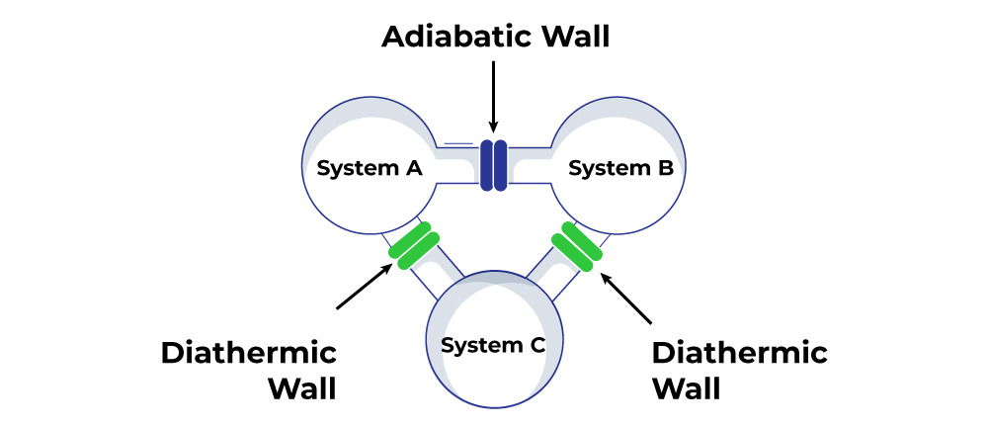
0th law of thermodynamic
If two thermodynamic systems are each in thermal equilibrium with the third one, then they are in thermal equilibrium with each other

Slide 10
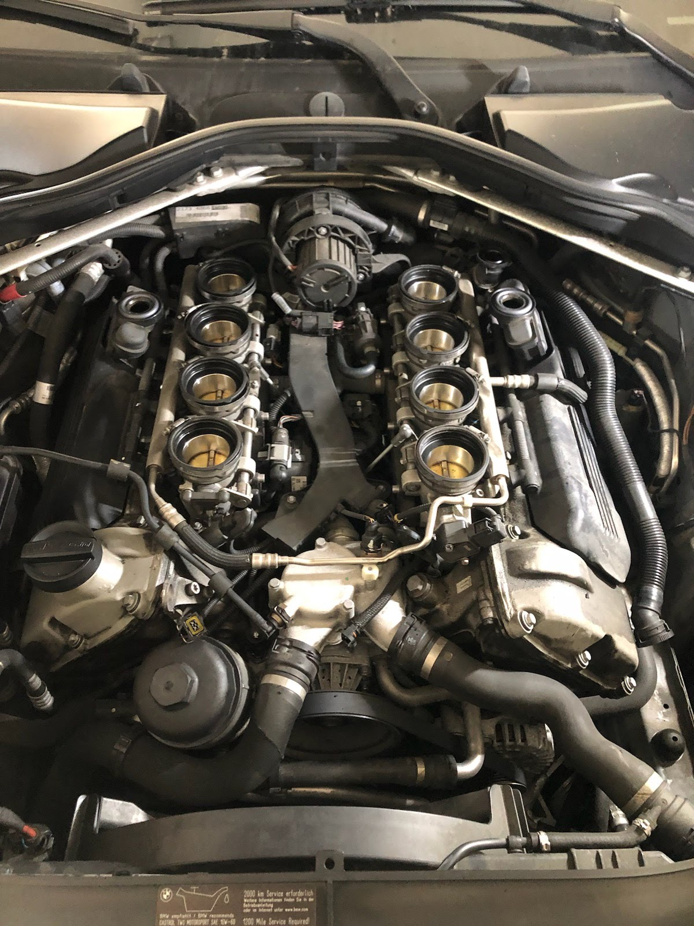
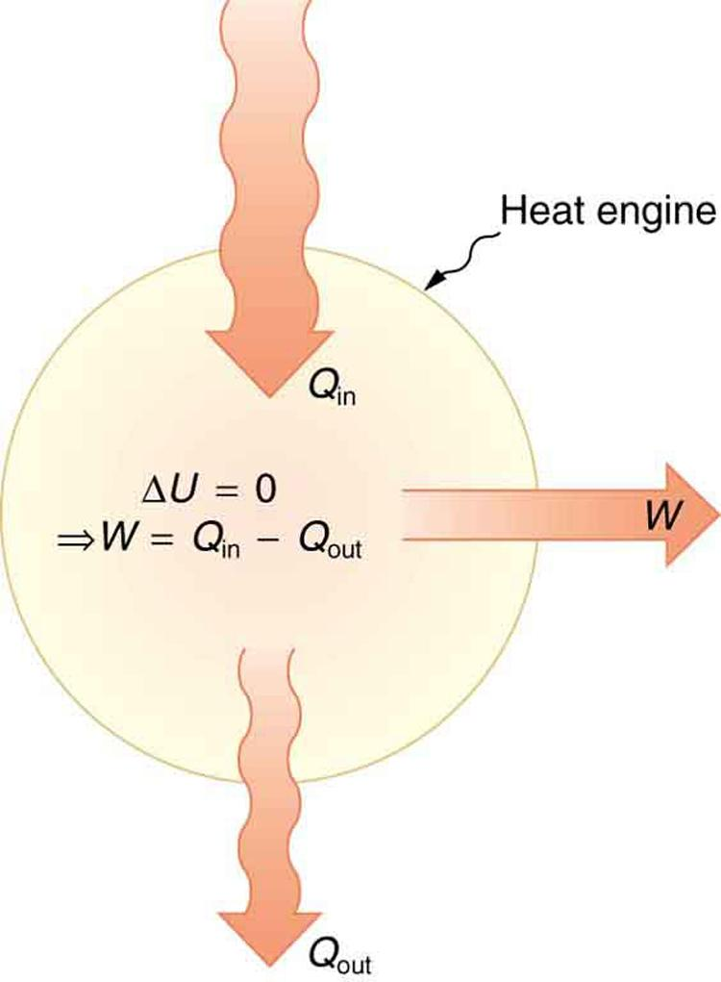
first law of thermodynamics
Energy is neither created nor destroyed. Energy of the universe is constant.

Slide 11

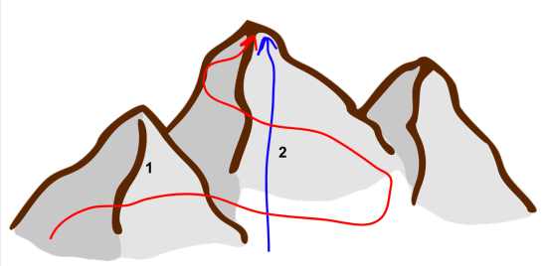
Define: state function
Mount Baldy hike (4000 ft elevation) – Two routes: Ski Hut trail (4 miles) or Devil's backbone (7 miles)
State of system that is independent of the path taken

Slide 12
Outline
Announcements
Ch. 6 & 18: Thermodynamics
Highlights of prior lecture
Enthalpy – Endothermic and exothermic processes
Specific Heat and Calculations
Calorimetry – Measuring energy changes
Enthalpy changes in chemical reactions

Slide 13
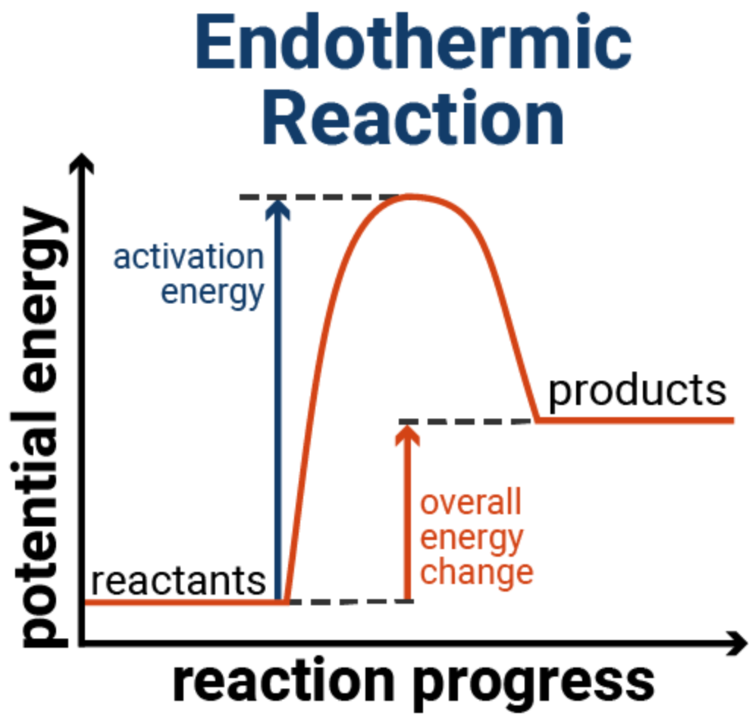
Endothermic processes
Generic reaction:
A + B --> C + D
Endothermic reaction – overall reaction results in positive change in energy (ΔE = E_{products} – E_{reactants})
Activation energy (E_{a}) – minimum amount of energy to start reaction

Slide 14
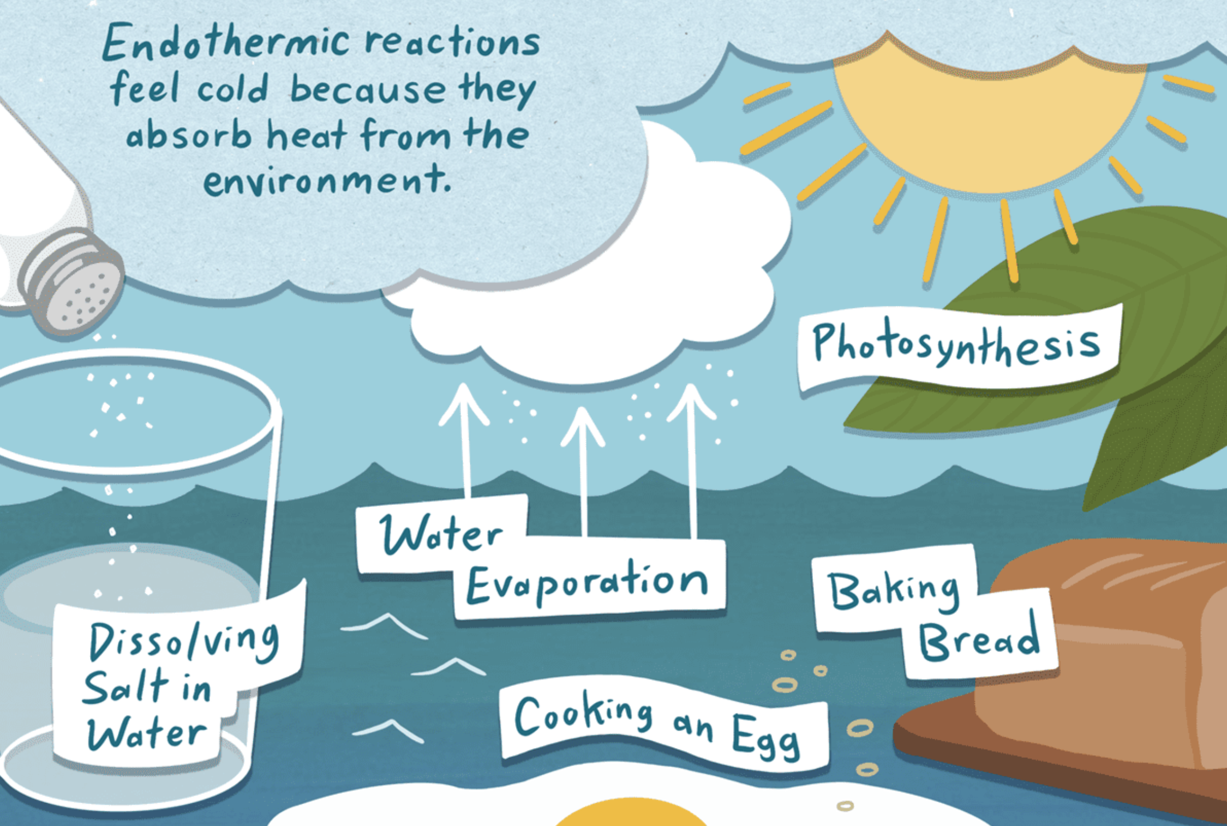
Examples of endothermic processes

Slide 15
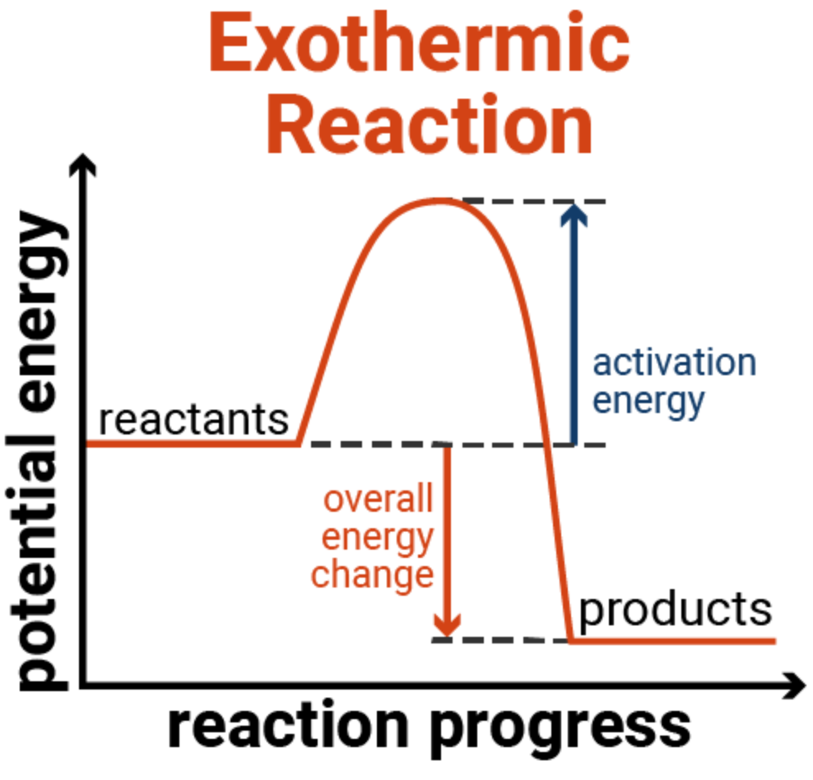
Exothermic processes
Generic reaction:
A + B --> C + D
Exothermic reaction – overall reaction results in negative change in energy (ΔE = E_{products} – E_{reactants})
Activation energy (E_{a}) – minimum amount of energy to start reaction

Slide 16
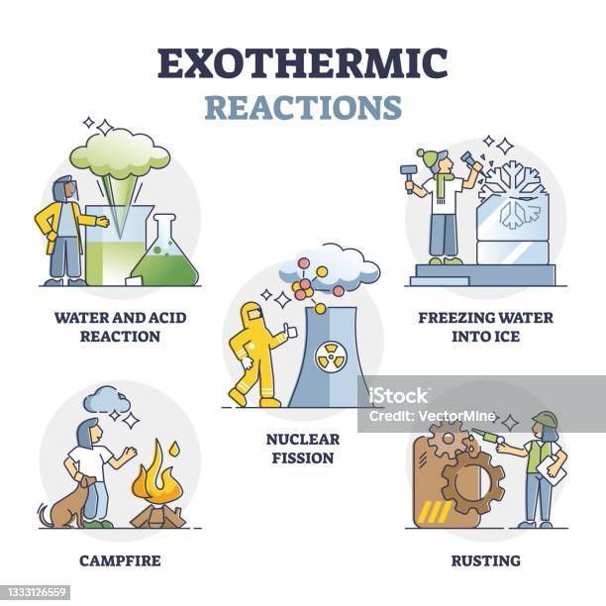
examples of exothermic processes

Slide 17
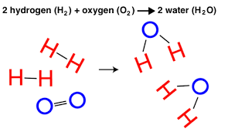
Q: How does a chemical reaction happen?
Molecules must collide
Molecules must collide with enough energy to begin to break the old bonds so new bonds can form (Activation energy)
Molecules must collide with the correct orientation

Slide 18
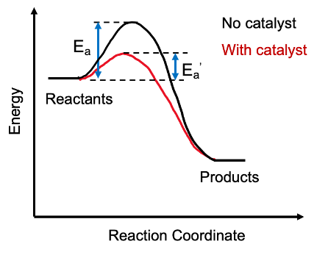
Q: How catalyst affects chemical reaction
Activation Energy (E_{a}) determines the rate of the reaction
Catalyst speeds up the reaction by lowering E_{a}

Slide 19
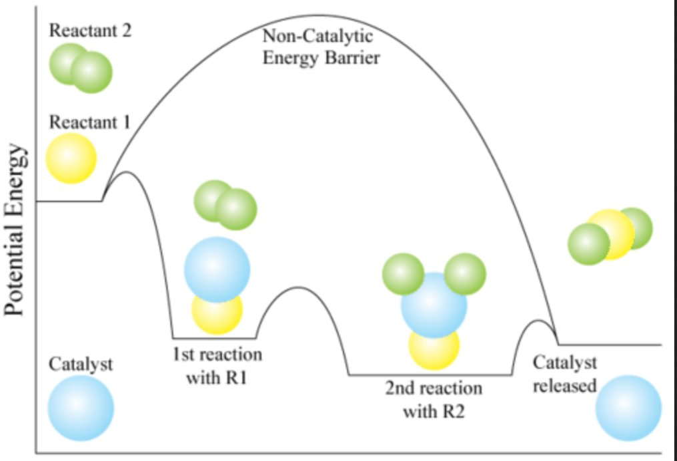
How catalyst affects chemical reaction
Catalysts facilitate the collisions between reactants

Slide 20
Outline
Announcements
Ch. 6 & 18: Thermodynamics
Highlights of prior lecture
Enthalpy – Endothermic and exothermic processes
Specific Heat and Calculations
Calorimetry – Measuring energy changes
Enthalpy changes in chemical reactions

Slide 21
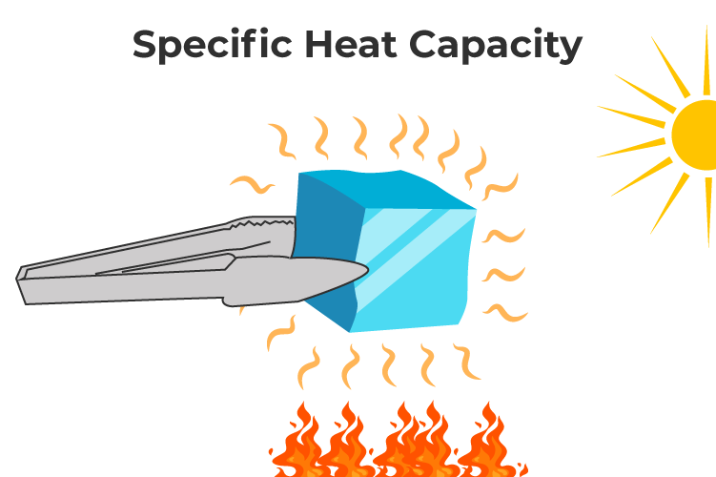
Quantifying heat
q = mcΔT
m is the mass of the material (grams)
c is the specific heat capacity (J/(g °C)) - amount of heat to heat a substance by 1 gram per 1 °C
ΔT is the change in temperature (°C)
ΔT = T_{final} - T_{initial}

Slide 22
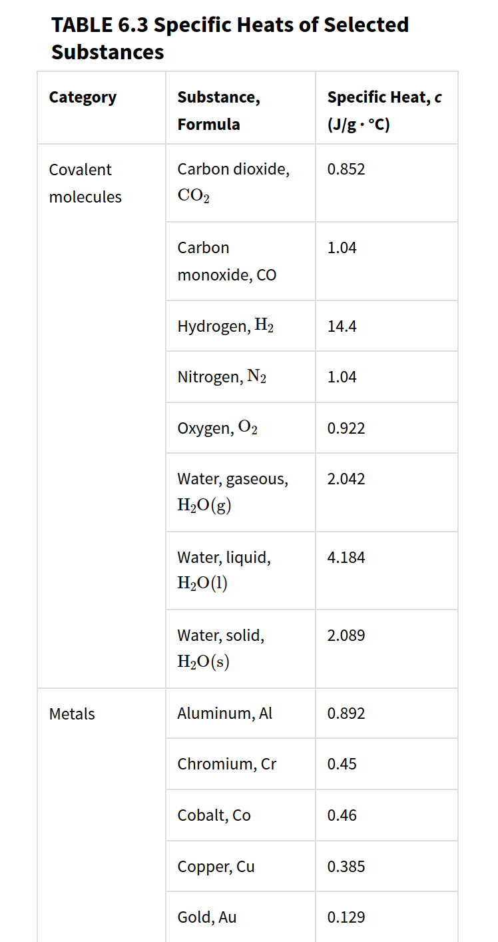
Specific heat capacity

Slide 23
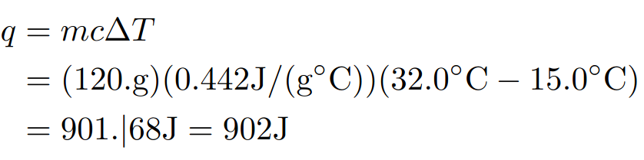
Heating Example
Calculate the amount of heat (J) required to raise the temperature of 120.g of iron from 15.0 °C to 32.0 °C. Specific heat of iron is 0.442
J/(g °C).

Slide 24
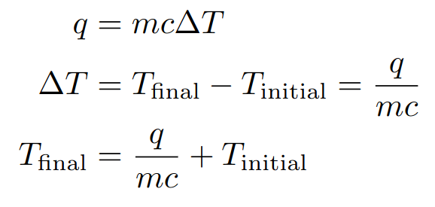
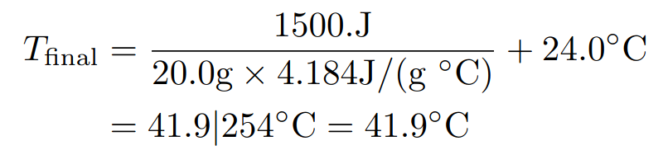
Adding energy Example
Calculate the final temperature after 1500. J of energy is added to 20.0g of water at 24.0 °C. Specific heat of liquid water is 4.184 J/(g °C).
Game plan: Write out the formula and algebraically solve the equation. Plug.

Slide 25
Your turn: removing energy
Suppose 1500. J of energy is removed from hot water at 80.0 °C. Calculate the final temperature. Specific heat of liquid water is 4.184 J/(g °C). Hint: keep in mind of sign conventions!

Slide 26
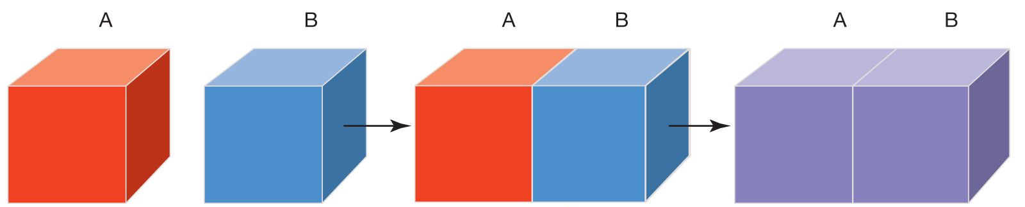
Thermal equilibrium
Thermal Equilibrium – When temperature balances out, lead to no net flow of energy between the two blocks
Block A is hotter than B -> heat flow from hot to cold reaching thermal equilibrium

Slide 27
Thermal equilibrium example
Suppose blocks A and B are of the same material and mass. Block A is at 100 °C and block B is at 50 °C. Both comes into contact reaching thermal equilibrium without losing energy to the surrounding. Intuitively, what is the temperature at thermal equilibrium?

Slide 28
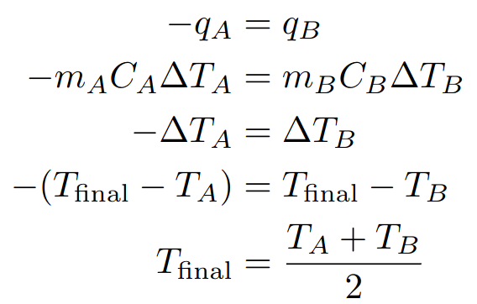
Thermal equilibrium example

Slide 29
Your turn: Thermal equilibrium Unequal masses
Suppose blocks A and B are of the same material but block A is 2 times heavier than block B (m_{A} = 2 m_{B}). Block A is at 100 °C and block B is at 50 °C. Both comes into contact reaching thermal equilibrium without losing energy to the surrounding. Write an algebraic expression determining the final temperature at thermal equilibrium.

Slide 30
Your turn: Thermal equilibrium different materials
Suppose blocks A and B are of the same mass but different materials (C_{A} =/= C_{B}). Block A is at 100 °C and block B is at 50 °C. Both comes into contact reaching thermal equilibrium without losing energy to the surrounding. Write an algebraic expression determining the final temperature at thermal equilibrium.

Slide 31
Outline
Announcements
Ch. 6 & 18: Thermodynamics
Highlights of prior lecture
Enthalpy – Endothermic and exothermic processes
Specific Heat and Calculations
Calorimetry – Measuring energy changes
Enthalpy changes in chemical reactions

Slide 32
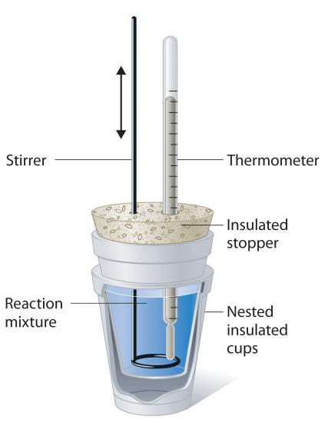
calorimetry
Method to measure the amount of heat transfer
Often performed in coffee cups to avoid losing heat to the surroundings

Slide 33
Calorimetry at constant pressure
At constant pressure, measuring the enthalpy of reaction (q = ΔH)

Slide 34
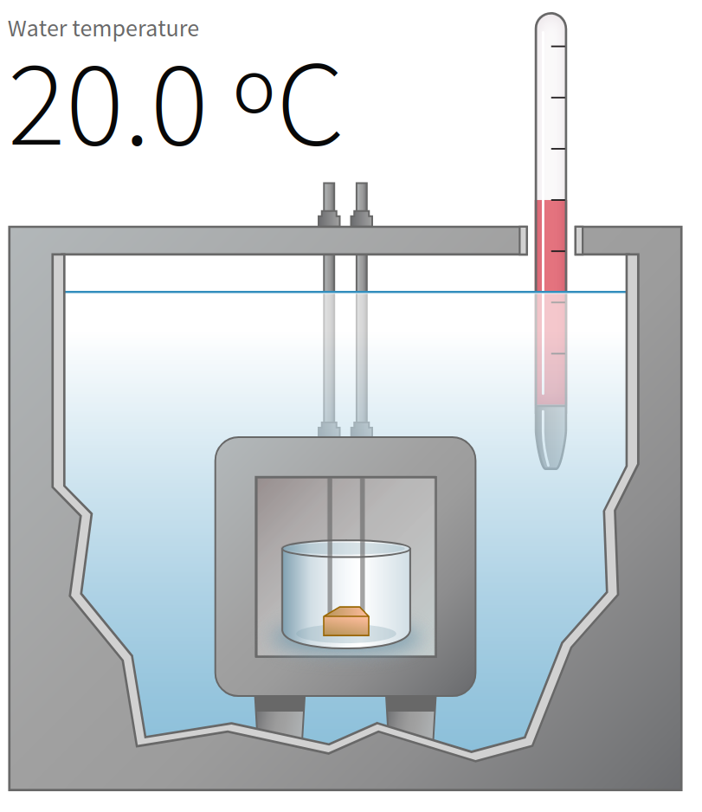
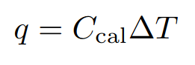
Calorimetry at constant volume
At constant volume, the experiments are held in bomb calorimetry withstanding high temperature and pressure
Constant volume means ΔU = q since w = PΔV = 0

Slide 35
Outline
Announcements
Ch. 6 & 18: Thermodynamics
Highlights of prior lecture
Enthalpy – Endothermic and exothermic processes
Specific Heat and Calculations
Calorimetry – Measuring energy changes
Enthalpy changes in chemical reactions

Slide 36
Enthalpy change in chemical reaction
A + B --> C + D
ΔH > 0, endothermic
ΔH < 0, exothermic
Understanding Enthalpy Change (ΔH)
Units are in kJ/mol reaction
2 H₂(g) + O₂(g) --> 2 H₂O(l) ΔH = -286 kJ/mol
Q: How much heat is released for 4 mols of H₂(g)? What about 3 mols O₂(g)?

Slide 37
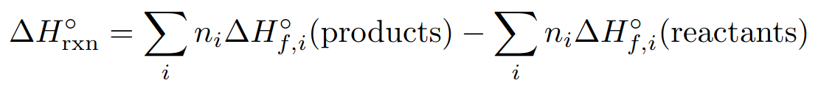
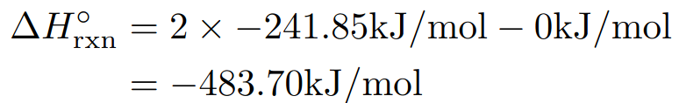
Formula to compute enthaly of chemical reactions
n is the mols for each compound obtained from the chemical equation
ΔH_{f} is the enthalpy of formation – energy to form said compound
Enthaly of formation for elements are zero
Example: 2 H₂(g) + O₂(g) --> 2 H₂O(g); enthalpy formation of water is –241.8 kJ/mol

